Slide 1
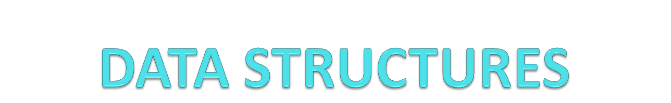
Introduction:
  Basic Concepts and Notations
  Complexity analysis: time space tradeoff
  Algorithmic notations, Big O notation
  Introduction to omega, theta and little o notation

Slide 2
Basic Concepts and Notations
Algorithm: Outline, the essence of a computational procedure, step-by-step instructions
Program: an implementation of an algorithm in some programming language
Data Structure: Organization of data needed to solve the problem

Slide 3

Classification of Data Structures
Data Structures
Primitive
Data Structures
Non-Primitive
Data Structures
Integer
Real
Character
Boolean
Linear
Data Structures
Non-Linear
Data Structures
Array
Stack
Queue
Linked List
Tree
Graph
Notes:
PRIMITIVE DATATYPE
The primitive data types are the basic data types that are available in most of the programming languages. The primitive data types are used to represent single values.
NON PRIMITIVE DATATYPES
The data types that are derived from primary data types are known as non-Primitive data types. These datatypes are used to store group of values.

Slide 4
Data Structure Operations
Data Structures are processed by using certain operations.
Traversing: Accessing each record exactly once so that certain items in the record may be processed.
Searching: Finding the location of the record with a given key value, or finding the location of all the records that satisfy one or more conditions.
Inserting: Adding a new record to the structure.
Deleting: Removing a record from the structure.

Slide 5
Special Data Structure-Operations
Sorting: Arranging the records in some logical order (Alphabetical or numerical order).
Merging: Combining the records in two different sorted files into a single sorted file.

Slide 6
Algorithmic Problem
Specification of input
Specification of output as a function of input
?
Infinite number of input instances satisfying the specification. For example: A sorted, non-decreasing sequence of natural numbers of non-zero, finite length:
  1, 20, 908, 909, 100000, 1000000000.
  3.

Slide 7
Algorithmic Solution
Specification of input
Specification of output as a function of input
Algorithm
Algorithm describes actions on the input instance
Infinitely many correct algorithms for the same algorithmic problem

Slide 8
What is a Good Algorithm?
Efficient:
  Running time
  Space used
Efficiency as a function of input size:
  The number of bits in an input number
  Number of data elements(numbers, points)
Notes:
Refer the notes.

Slide 9
MCQs
. Which of these best describes an array?
a) A data structure that shows a hierarchical behaviour
b) Arrays are immutable once initialised
c) Container of objects of similar types
d) Array is not a data structure

Slide 10
How do you initialize an array in C?
a) int arr[3] = (1,2,3);
b) int arr(3) = {1,2,3};
c) int arr[3] = {1,2,3};
d) int arr(3) = (1,2,3);

Slide 11
How do you instantiate an array in Java?
a) int arr[] = new int(3);
b) int arr[];
c) int arr[] = new int[3];
d) int arr() = new int(3);

Slide 12
Which of the following is a correct way to declare a multidimensional array in Java?
a) int[] arr;
b) int arr[[]];
c) int[][]arr;
d) int[[]] arr;

Slide 13
What are the advantages of arrays?
a) Objects of mixed data types can be stored
b) Elements in an array cannot be sorted
c) Easier to store elements of same data type
d) Index of first element of an array is 1

Slide 14
What are the disadvantages of arrays?
a) Data structure like queue or stack cannot be implemented
b) There are chances of wastage of memory space if elements inserted in an array are lesser than the allocated size
c) Index value of an array can be negative
d) Elements are sequentially accessed

Slide 15
Assuming int is of 4bytes, what is the size of int arr[15];?
a) 15
b) 19
c) 11
d) 60

Slide 16
Complexity analysis
Why we should analyze algorithms?
  Predict the resources that the algorithm requires
    Computational time (CPU consumption)
    Memory space (RAM consumption)
    Communication bandwidth consumption
  The running time of an algorithm is:
    The total number of primitive operations executed (machine independent steps)
    It is a determination of order of magnitude of statement.
    Also known as algorithm complexity
Notes:
Refer the Notes

Slide 17
Time Complexity
Worst-case
  An upper bound on the running time for any input of given size
Average-case
  Assume all inputs of a given size are equally likely
Best-case
  The lower bound on the running time

Slide 18
Time Complexity – Example
Sequential search in a list of size n
  Worst-case:
    n comparisons
  Best-case:
    1 comparison
  Average-case:
    n/2 comparisons

Slide 19
time space tradeoff
A time space tradeoff is a situation where the memory use can be reduced at the cost of slower program execution (and, conversely, the computation time can be reduced at the cost of increased memory use).
A space-time or time-memory tradeoff is a way of solving a problem or calculation in less time by using more storage space (or memory), or by solving a problem in very little space by spending a long time.

Slide 20
time space tradeoff
As the relative costs of CPU cycles, RAM space, and hard drive space change—hard drive space has for some time been getting cheaper at a much faster rate than other components of computers—the appropriate choices for time space tradeoff have changed radically.
Often, by exploiting a time space tradeoff, a program can be made to run much faster.

Slide 21
Asymptotic notations
Algorithm complexity is rough estimation of the number of steps performed by given computation depending on the size of the input data
  Measured through asymptotic notation
    O(g) where g is a function of the input data size
  Examples:
    Linear complexity O(n) – all elements are processed once (or constant number of times)
    Quadratic complexity O(n²) – each of the elements is processed n times

Slide 22
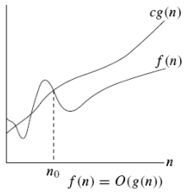

Big-O Notation (O)
Asymptotic Upper Bound
Notes:
Where,
C>0 & n₀>=1
Also Known as Worst Case Complexity

Slide 23
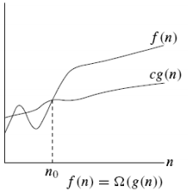

Omega Notation (Ω)
Asymptotic Lower Bound
Notes:
Where,
C>0 & n₀>=1
Also Known as Best Case Complexity

Slide 24
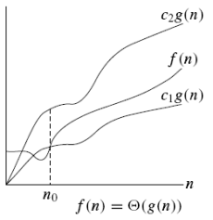

Theta Notation (Θ)
g(n) is an asymptotically tight bound of f(n)
Notes:
C₁>0, C₂>0, N₀>=1
Also Known as Average Time Complexity

Slide 25
Big O notation
f(n)=O(g(n)) iff there exist a positive constant c and non-negative integer n₀ such that
f(n) ≤ cg(n) for all n≥n0.
g(n) is said to be an upper bound of f(n).

Slide 26
Basic rules
1. Nested loops are multiplied together.
2. Sequential loops are added.
3. Only the largest term is kept, all others are dropped.
4. Constants are dropped.
5. Conditional checks are constant (i.e. 1).

Slide 27
Example 1
//linear
for(int i = 0; i < n; i++) {
cout << i << endl;
}

Slide 28
Ans: O(n)

Slide 29
Example 2
//quadratic
for(int i = 0; i < n; i++) {
for(int j = 0; j < n; j++){
//do swap stuff, constant time
}
}

Slide 30
Ans O(n^2)

Slide 31
Example 3
for(int i = 0; i < 2*n; i++) {
cout << i << endl;
}

Slide 32
At first you might say that the upper bound is O(2n); however, we drop constants so it becomes O(n)

Slide 33
Example 4
//linear
for(int i = 0; i < n; i++) {
cout << i << endl;
}
//quadratic
for(int i = 0; i < n; i++) {
for(int j = 0; j < n; j++){
//do constant time stuff
}
}

Slide 34
Ans : In this case we add each loop's Big O, in this case n+n^2. O(n^2+n) is not an acceptable answer since we must drop the lowest term. The upper bound is O(n^2). Why? Because it has the largest growth rate

Slide 35
Example 5
for(int i = 0; i < n; i++) {
for(int j = 0; j < 2; j++){
//do stuff
}
}

Slide 36
Ans: Outer loop is 'n', inner loop is 2, this we have 2n, dropped constant gives up O(n)

Slide 37

Example 6
x=y+z;
for(i=1; i<= n; i++)
x=y+z;
for(i=1; i<=n/2; i++)
for(j=1; j<=n; j++)
x=y+z;
Notes:
O(n²

Slide 38
Example 7
x=y+z;
for(i=1; i<= n; i++)
x=y+z;
for(i=1; i<=n; i++)
for(j=1; j<=n; j++)
x=y+z;
a=b+c;
Notes:
O(n²

Slide 39
Example 8
while(n>1)
{
n=n-1;
a=b+c;
}
Notes:
O(n)

Slide 40
Example 10
while(n>=1)
{
n=n-20;
n=n-5;
n=n-2;
}
Notes:
n/27 O(n)

Slide 41
Example 11
while(n>=1)
{
n=n-20;
n=n+5;
n=n-30;
}
Notes:
n/45 O(n)

Slide 42
Example 12
while(n>=1)
{
n=n/2;
}
Notes:
log₂n

Slide 43
Example 13
while(n>=1)
{
n=n/2;
n=n/3;
}
Notes:
O(log₆n)

Slide 44
Example 14
while(n>=1)
{
n=n-2;
n=n/2;
}
Notes:
O(log₂n)

Slide 45
Example 15
for(int i = 1; i < n; i *= 2) {
cout << i << endl;
}

Slide 46
There are n iterations, however, instead of simply incrementing, 'i' is increased by 2*itself each run. Thus the loop is log(n).

Slide 47
Example 16
for(int i = 0; i < n; i++) { //linear
for(int j = 1; j < n; j *= 2){ // log (n)
//do constant time stuff
}
}

Slide 48
Ans: n*log(n)

Slide 49
Example 17
while(n>2)
{
n=√n;
}
Notes:
O(log logn)

Slide 50
Example 18
while(n>2)
{
n=n^{2;}
n=√n;
n=n-2;
}
Notes:
O(n)

Slide 51
Example 19
x=y+z;
for(i=1; i<= n; i++)
{
j=2;
while(j<=n)
{
j=j^{2;}
}
}
Notes:
O(n.log(log₂n))

Slide 52
Example 20
Main()
{
While(n>2)
{
n=√n;
n=n/2;
n=n-2;
}
}
Notes:
O(log(logn))

Slide 53
Example 21
main()
{
While(n>1)
{
n=n/2;
a=a+b;
}
}
Notes:
2*logn=O(logn)

Slide 54
Example 22
main()
{
While(n>=1)
{
n=n/2;
}
}
Notes:
Logn+1→ O(logn)

Slide 55
Example 23
main()
{
While(n³>1)
{
n=n-1;
a=b+c;
X=x+y;
}
}
Notes:
3(n³-1)→ O(n³)

Slide 56
Example 24
main()
{
for(i=1;i<=n;i=3*i)
  {j=1;
While(j<=n)
{
j=j*3;
}
}
}
Notes:
O(log₃)²

Slide 57
Example 25
main()
{
for(i=1;i<=n;i++)
{
for(j=1;j<=i;j++)
    {
    for(k=1;i<=143;k++)
    {
    x=y+z;
    }
    }
}
}
Notes:
1*143+2*143+3*143+4*143+-------n*143
143(1+2+3+-----n)
143((n(n+1))/2)=143(n²)
So final answer O(n²)

Slide 58
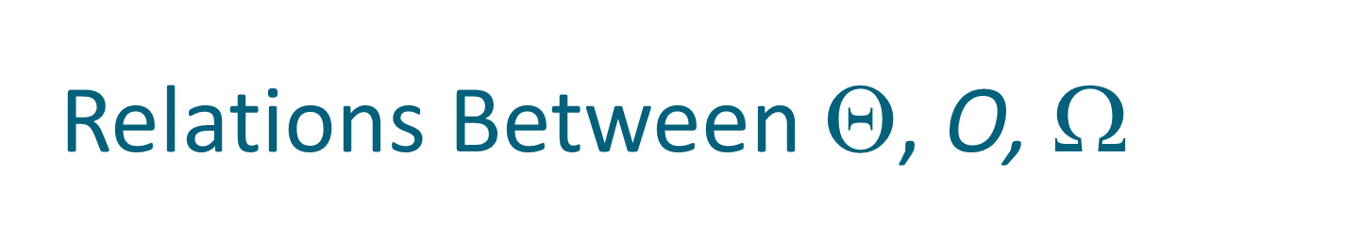



Comp 122

Slide 59
Thank You

